Slide 1


Classifying Student Academic Performance Using Machine Learning
[Shivani Guduru] | [23081838]

Slide 2



Introduction
Improving education quality is a global concern, leading to the rise of Educational Data Mining (EDM).
A key task in EDM is predicting Student Academic Performance (SPP). By employing machine learning, we can forecast outcomes like grades or completion rates.
Goal: Develop efficient early warning systems to pinpoint students at risk of failure or dropout, enabling timely pedagogical interventions.

Slide 3


Background
Classification
Regression
Predicts binary outcomes (e.g., Pass vs. Fail).
Predicts continuous numerical grades.
These models often exhibit high accuracy and dependability. They are indispensable for teachers to identify "at-risk" students early.
Methodologically more complex. Research indicates regression models often struggle to beat simple baselines due to data granularity issues.

Slide 4
Problem Statement
Data Challenges
High dimensionality and Class Imbalance (more passing students than failing) undermine model stability if not addressed.
Ranking Predictors
Identifying which specific student characteristics are most influential is often overlooked but essential for targeted interventions.
The "Black Box" Issue
Complex algorithms yield high accuracy but lack interpretability. Educators need actionable insights, not just predictions.

Slide 5



Aim and Objectives
To use ML algorithms to predict academic performance with high accuracy and interpretability.
1
2
3
Assess Accuracy
Rank Attributes
Interpretability
Evaluate different ML algorithms in predicting student outcomes (Pass/Fail).
Pinpoint key predictors like study habits and socio-economic factors.
Compare actionable insights from interpretable models vs. black-box algorithms.

Slide 6
Research Questions
RQ1: How accurately can machine learning models classify student outcomes into performance categories based on academic, behavioral, and socio-economic features?
RQ2: Which student attributes (e.g., study habits, parental education, socio-economic background) are the most influential predictors of academic success?
RQ3: What type of actionable insights do interpretable machine learning models provide for educators compared to complex black-box algorithms?

Slide 7



Literature Review
IMRAN ET AL. (2019)
LAU, SUN & YANG (2019)
Used J48 Decision Tree Ensemble. Achieved 95.78% accuracy by addressing class imbalance.
Used ANN (Neural Networks). Achieved 84.8% accuracy using socio-economic and entrance exam data.
DO & CHEN (2013)
STRECHT ET AL. (2015)
Used Neuro-Fuzzy Classifier (NFC). Achieved 90.03% accuracy, outperforming standard algorithms.
Compared Classification vs Regression. Found classification effective, but regression failed to beat baselines.
GAP IDENTIFIED
Interpretability & Methodology: Previous studies often ignore data dimensionality/imbalance issues. More importantly, "black box" models fail to provide the actionable insights educators need for policy making.

Slide 8

Dataset Information
Features Overview
Source
Contains academic, demographic, and socio-economic data.
Collected By: Paulo Cortez & Alice Silva (Univ. of Minho, Portugal, 2008).
Repository: UCI Machine Learning Repository.
Context: Students from two Portuguese secondary schools.

Slide 9
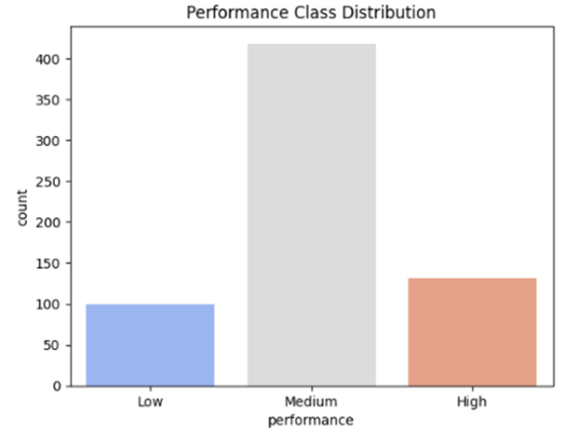
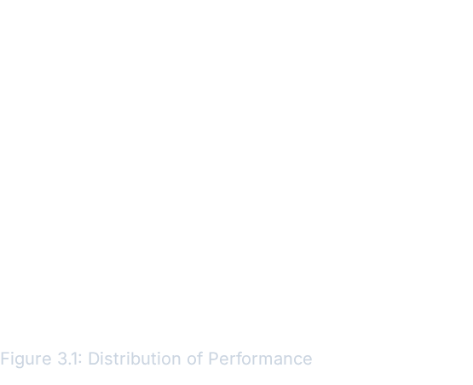
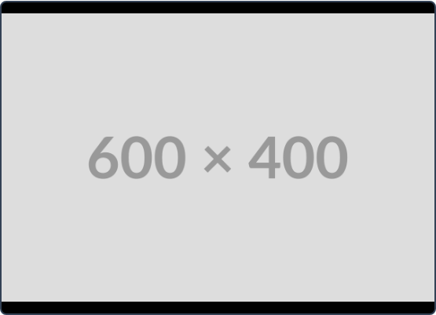
EDA: Performance Distribution
Analysis
The distribution graph highlights the class imbalance issue identified in the problem statement.
The majority of students fall into the "Medium" performance category, while the "Low" and "High" classes are underrepresented. This imbalance requires specific pre-processing (like SMOTE) to prevent model bias.

Slide 10
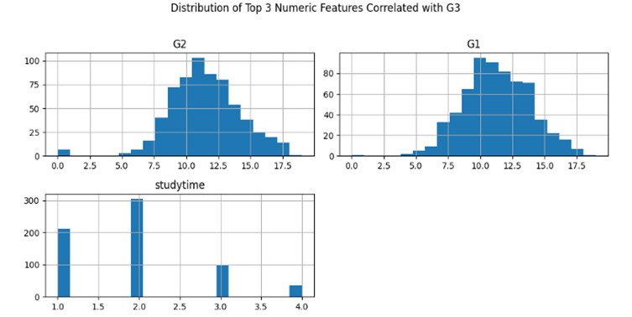
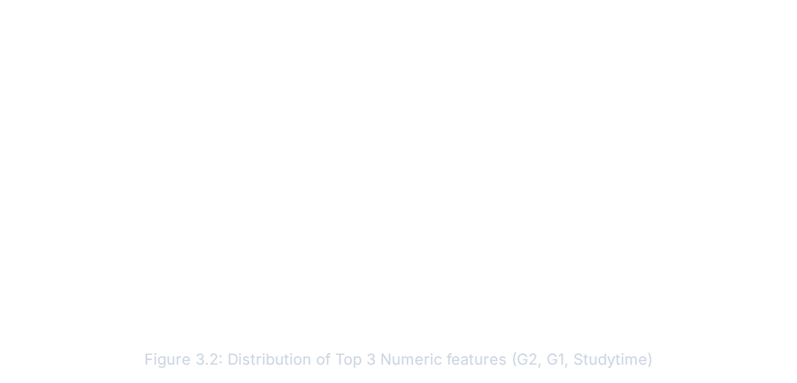
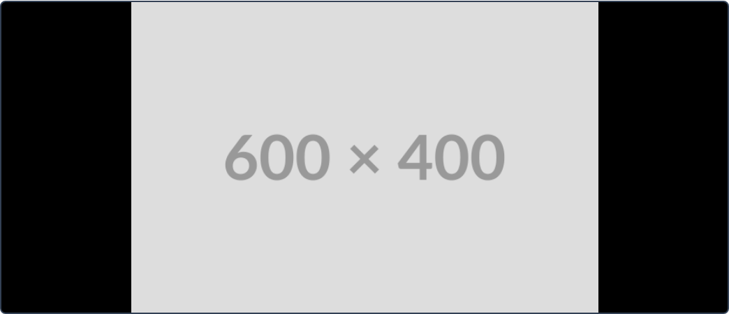
EDA: Distribution of Top 3 Numeric Features

Slide 11
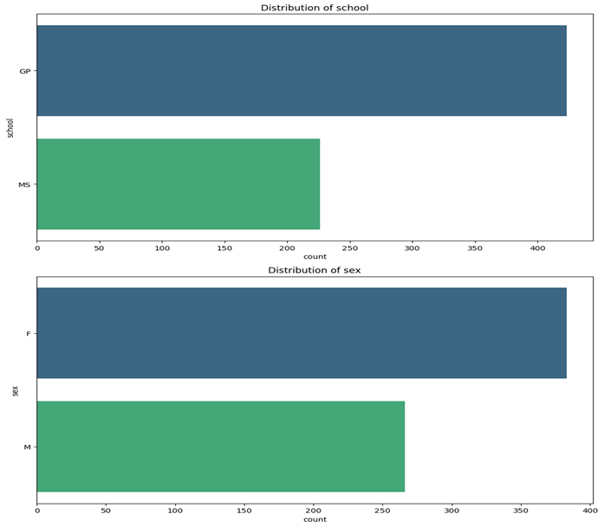
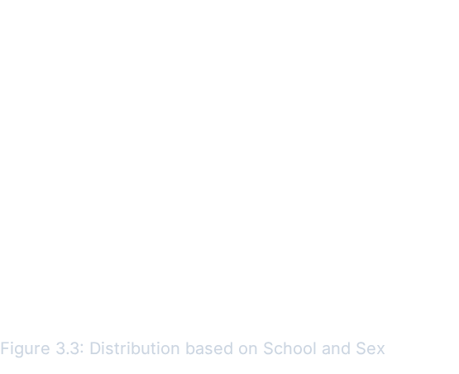
EDA: Demographic Distribution
Demographic Insights
School: The dataset is dominated by students from the Gabriel Pereira (GP) school compared to Mousinho Silveira (MS), potentially introducing location bias.
Gender: The distribution between Male and Female students is relatively balanced.

Slide 12
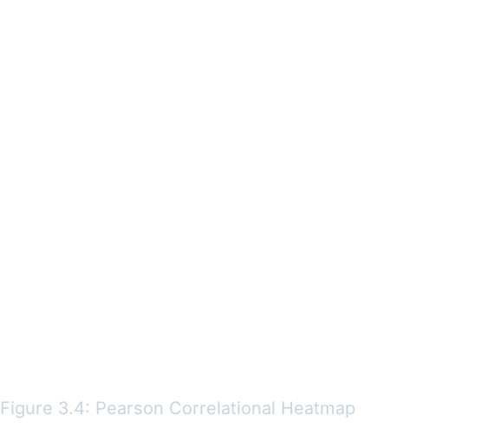
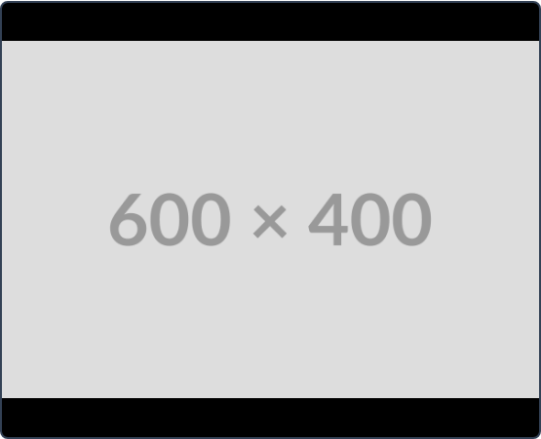
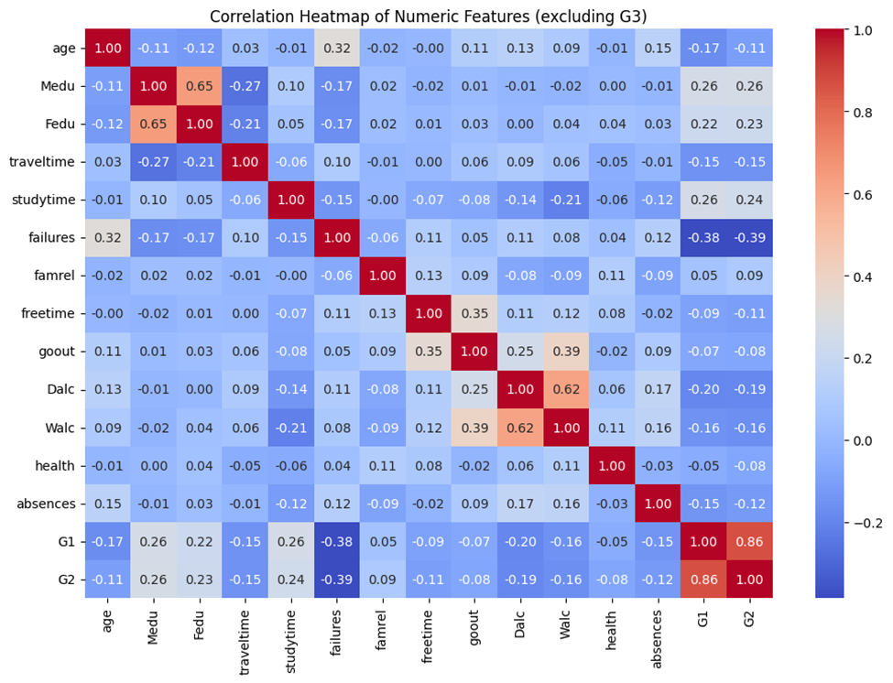
EDA: Correlation Analysis
Analysis
The Pearson Heatmap confirms that academic history (Grades/Failures) dominates prediction power over socio-economic factors.
Positive: G1 and G2 are strongly correlated with G3.
Negative: Past failures have a significant negative correlation with final performance.

Slide 13



Feature Selection & Pre-Processing
Step 1: Feature Separation
Separating Target Variable (y = 'performance') from Features (X).
↓
Numeric Pipeline
Categorical Pipeline
For quantitative data (e.g., Age, Absences)
For qualitative data (e.g., Job, School)
Fills missing values with median (robust to outliers) and scales data to unit variance.
Fills missing values with the mode and converts categories into binary vectors.
Step 3: Final ColumnTransformer
Combines both pipelines to output a fully processed, machine-readable feature matrix ready for training.

Slide 14
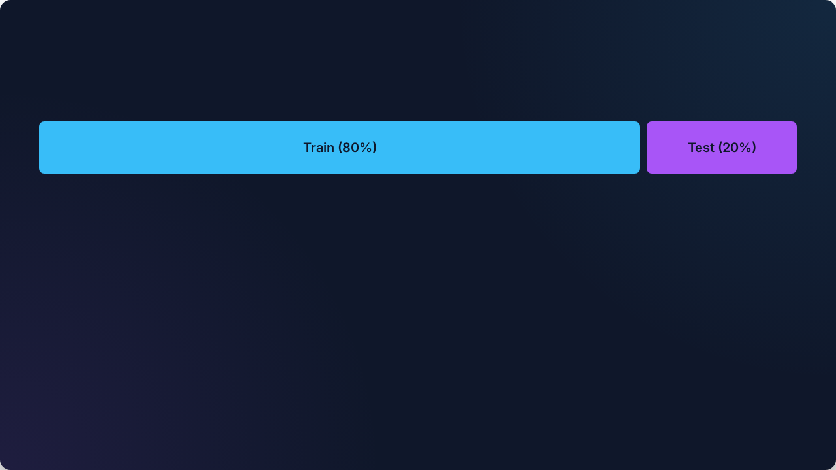




Data Splitting & Dimensions
TRAINING SET
TESTING SET
Raw Shape:
Raw Shape:
Processed Shape:
Processed Shape:

Slide 15
Model Configurations
Model Name | Key Parameters | Details
Logistic Regression | max_iter=1000 multi_class="auto" | Serves as a linear baseline for classification comparisons.
K-Nearest Neighbors (KNN) | n_neighbors=7 | Distance-based classifier useful for finding local patterns.
Support Vector Classifier (SVC) | kernel="rbf" probability=True random_state=42 | Non-linear classifier utilizing Radial Basis Function kernel. Probability enabled for ROC analysis.

Slide 16




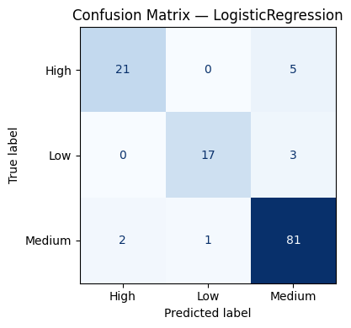
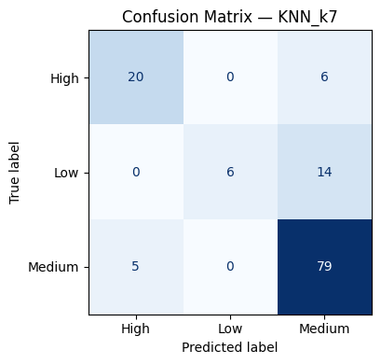
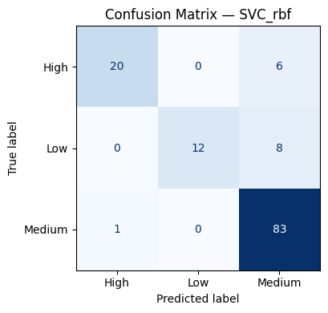

Model Evaluation: Cross-Validation
Logistic Regression
KNN (k=7)
SVC (RBF)
Accuracy (Mean ± SD) 0.923 ± 0.018
Accuracy (Mean ± SD) 0.789 ± 0.029
Accuracy (Mean ± SD) 0.887 ± 0.013
F1-Macro (Mean ± SD) 0.904 ± 0.024
F1-Macro (Mean ± SD) 0.678 ± 0.046
F1-Macro (Mean ± SD) 0.844 ± 0.020
ROC-AUC (Mean ± SD) 0.985 ± 0.009
ROC-AUC (Mean ± SD) 0.913 ± 0.021
ROC-AUC (Mean ± SD) 0.980 ± 0.007
Fastest training time (linear)
Lowest stability/highest variance
Highest training time (non-linear)

Slide 17

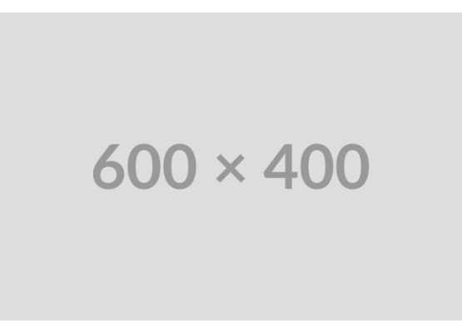
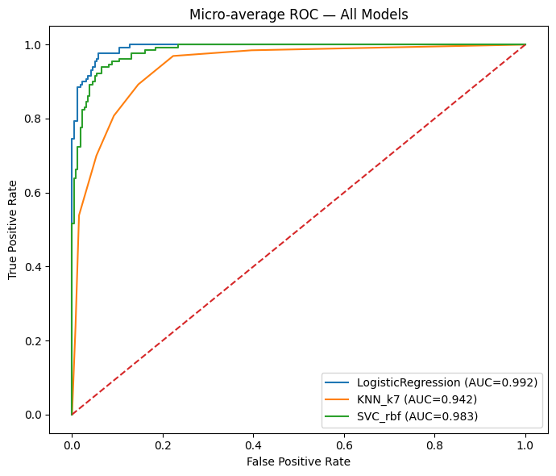
ROC Curve Analysis
Receiver Operating Characteristic
The ROC curves illustrate the diagnostic ability of our classifiers. Logistic Regression clearly outperforms the others with a macro-average AUC of 0.985 (Mean CV Score).
LogReg (0.985): Excellent separation and high stability.
SVC (0.980): Very strong non-linear performance, close second.
KNN (0.913): Lowest performance, indicating local patterns are less effective than global features.

Slide 18


Stratified K-Fold CV
Due to the small size of the dataset and the class imbalance (as seen in Figure 3.1), Stratified K-Fold Cross-Validation (CV) was essential to ensure robust and unbiased model evaluation.
Key CV Results Summary (k=5)
Model | Accuracy (Mean)
LogReg | 92.3%
SVC | 88.7%
KNN | 78.9%
Why Stratified?
Ensures that each of the K folds has the same proportion of target classes ('Low', 'Medium', 'High') as the original dataset. This is critical when dealing with minority classes like 'Low' performance.
The low Standard Deviation (SD) in LogReg's performance (±0.018) confirms its stability across all folds.
Why Cross-Validation?
Provides a more reliable estimate of a model's real-world performance by training and testing the model K times on different subsets. This minimizes the risk of overfitting to a single train/test split.

Slide 19







What is Next?
Feature Importance
Model Interpretability
Hyperparameter Tuning
Apply feature importance techniques (e.g., LogReg coefficients, Permutation Importance) to **rank student attributes** that drive prediction.
Use explainable AI (XAI) techniques like **LIME or SHAP** to explain individual student predictions. This demonstrates the model's value over a black box.
Refine the best-performing models (LogReg, SVC) using techniques like Grid Search or Bayesian Optimization to **maximize performance and robustness**.

